Slide 1
Relay
8V
Voltage
Regulator
Webcam
5x Servo
Power LED
USB
Image Grabber
Image
Stream
Face Recognition
Faces
Trajectory
Planning
60Hz
PWM
400Hz
PWM
I²C
trajectory
Power
Control
PWM generator
I²C
Bezier Interpolation
shade
tensor
Kinematics
5x servo angle
1x LED
ODROID U3
ATmega328

Slide 2
curve after limiting acceleration to ½ g
Original bezier curve

Slide 3
Computing support points of a cubic bezier curve
A‘
A‘ := A mirrored at B
B‘ := angle bisector of BA‘ and BC with length |BC|/3
B‘
C‘
C
B
A
D

Slide 4
Reverse Kinematics
Getting servo angles from point A
B
A
y
D
C
E
z
F
x

Slide 5
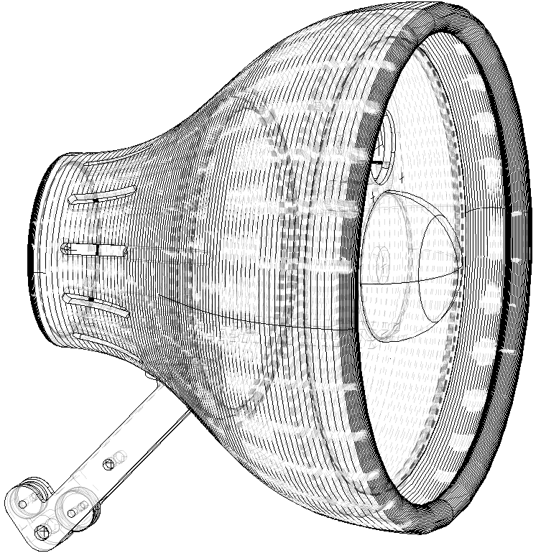
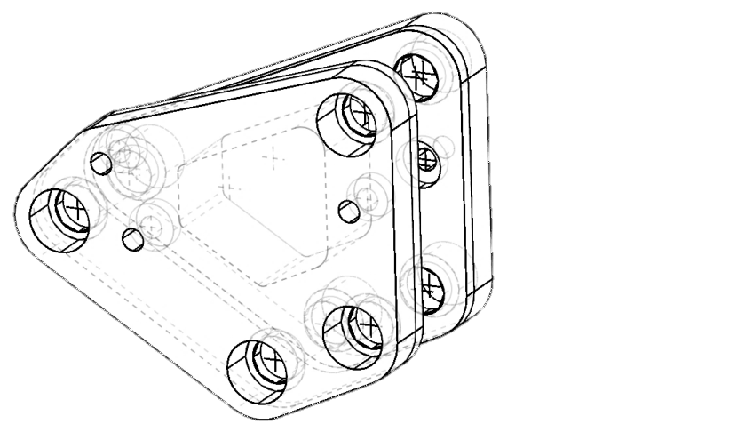
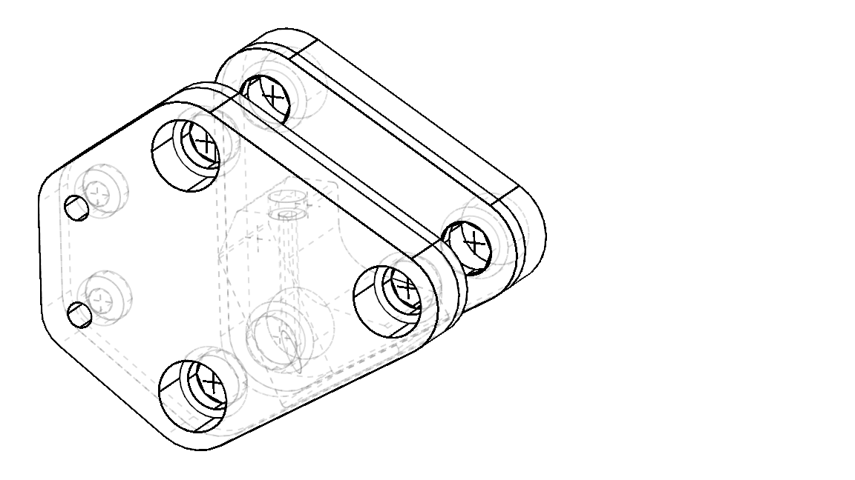
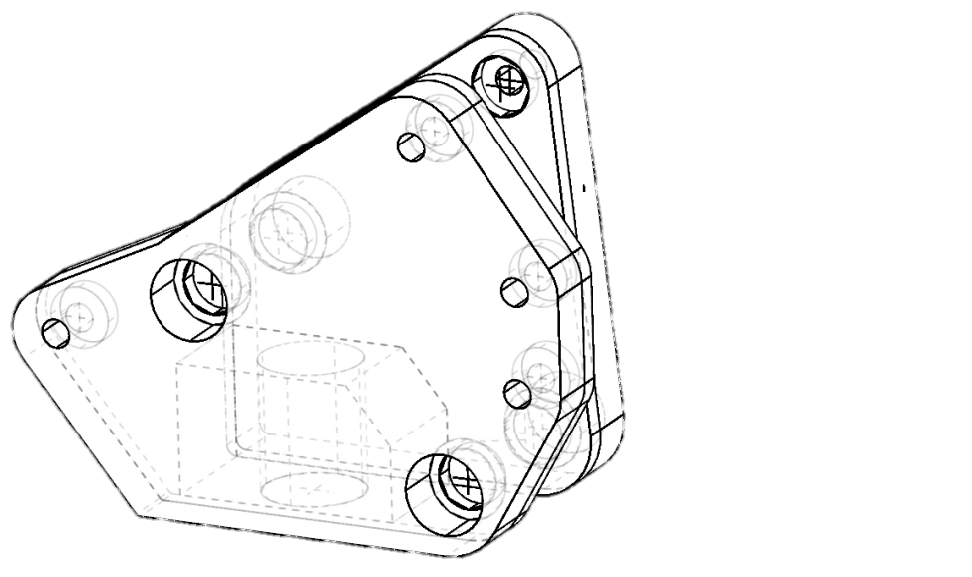

Slide 6
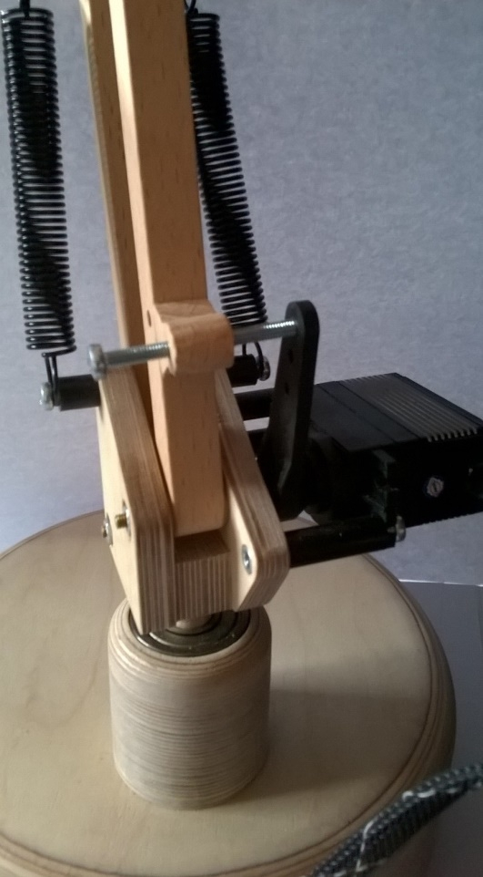
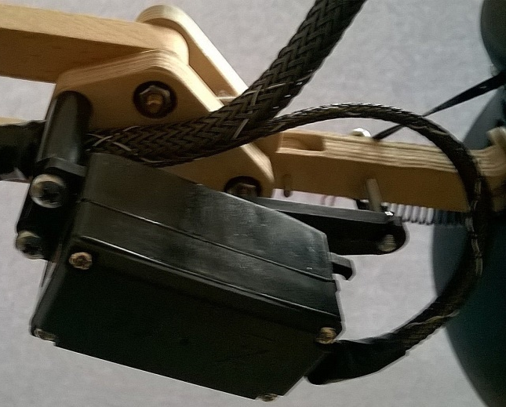
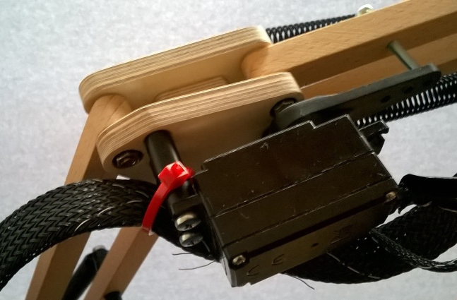

Slide 7
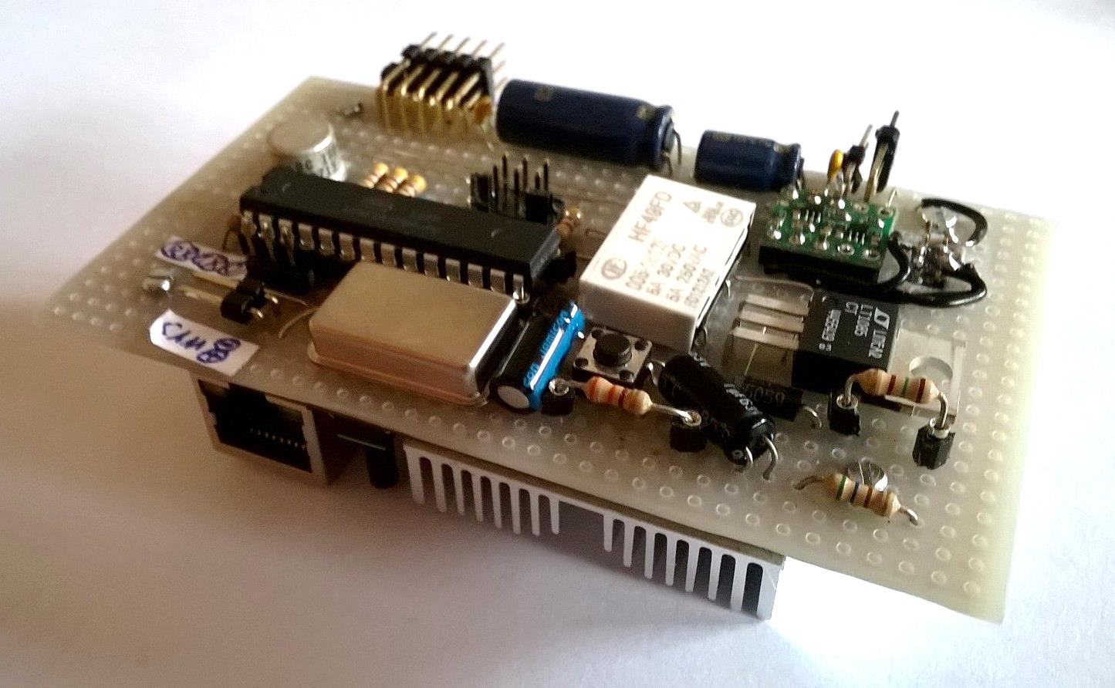
ODROIDs I/O Port connected to the ATMega via I²C.
I‘m not proud
of that layout

